Slide 1

Scotiabank AML Solution
X
IMI Big Data Competition
Presented by Team 6 Co-MMA
Notes:
Hello everyone from ScotiaBank and the panel of judges. Thank you for having us here today.

Slide 2





Team Co-MMA
Alan
Liu
Humza
Butt
Kevin Zhang
Devashree Kumar
Master of Management Analytics
Notes:
My name is Kevin, and here we have my teammate Alan, Humza, and Devashree with us, & we are all part of the team COMMA from the Master of Management Analytics Program at Rotman.

Slide 3

Agenda
Background
Data Processing and EDA
Modeling Approach
Clustering & Segmentation
Adapt to Big Data
Recommendations
Notes:
I will be here to walk you through quickly on the agenda for today. We will start off with some background on the problem we are given alongside with the data processing that we have performed. Followed by the modeling approach for predictive analysis. Then we will be presenting the clustering and segmentation for the big data to provide some recommendation.

Slide 4
Background
Notes:
I will start off with the background of the project.

Slide 5

Background
Anti Money Laundering(AML)
The Ask:
Which individual customers are considered to be
high risk for money laundering?
Background:
Money laundering is an illegal action to use layering of accounts to clean dirty money
2 - 5% of Global Economy are associated with Money laundering
Scotiabank has labeled a few data with the risk profile for money laundering and wish to use those to identify all the accounts with high risks
Notes:
Money laundry is an illegal action that is to use layering the accounts to clean illegal obtained money. A research has shown that the 2 to 5 % of the global economy are associated with Money laundering. Therefore, recently, money laundering is considered to a major concern across all financial institute. We are delighted to be part of the ScotiaBank’s Anti Money Laundry campaign in supporting the data scientist in identifying all the accounts with high risks for money laundry. We have provided with a few data with labeled risk profile in order to develop a model in support the campaign.

Slide 6
2. Data Processing & EDA
Preliminary Analysis
Notes:
I will quickly talking us through about the Data Processing and Exploratory analysis that we have completed.

Slide 7


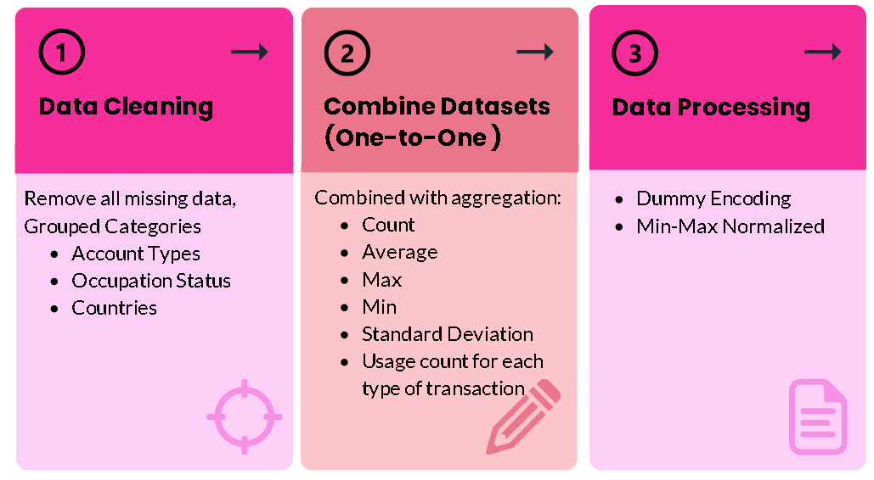
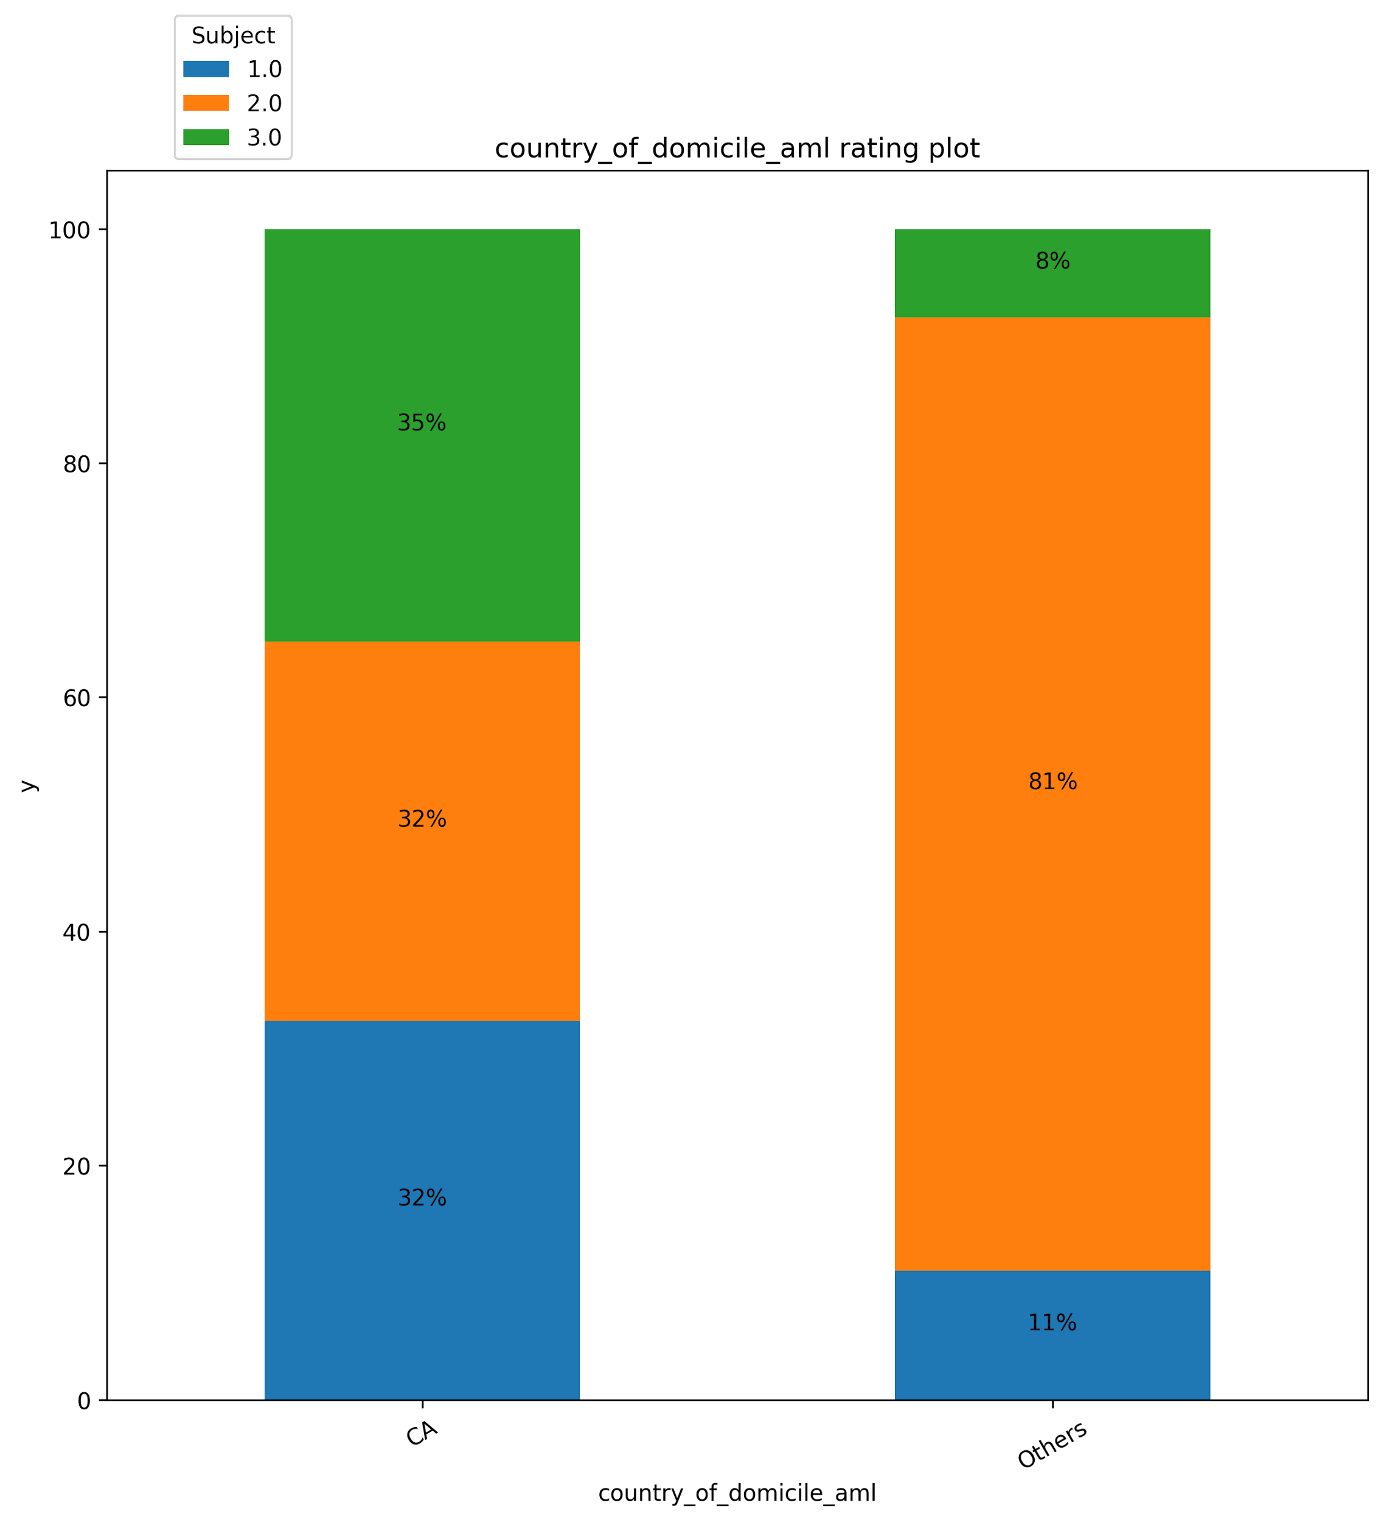
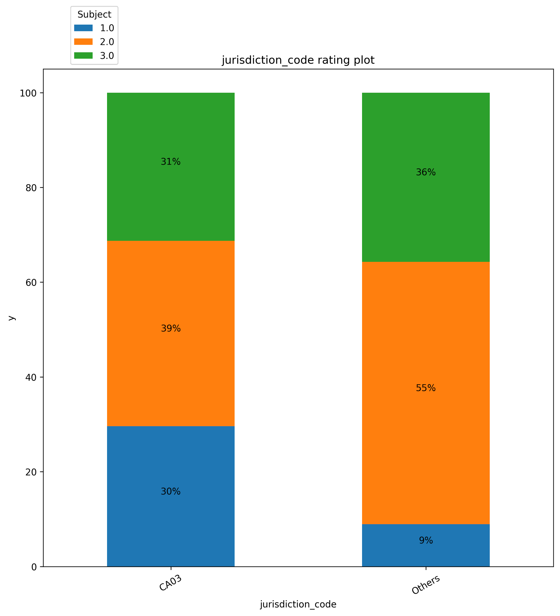
Data Preprocessing
X
Data Overview
Dataset Used
Assumption
Customer data
Transaction data
Training set is not a full representation of the big dataset
Emphasis on the Canadian individual customers
Preprocessing
Country: Canada vs Others
Appendix Attached
Notes:
The available given data are customer data and transaction data for each customers. Through conducting preliminary analysis, we have discovered that the training set is not a full representation of the big dataset. Therefore, we have decided to narrow down the scope to emphasis on the Canadian individual customers which reduces the country code and removed all the business accounts in the data.
We have combined the datasets for the one-to-one relationship to obtain the aggregation of transaction sum, average, standard deviation and etc. And the data is processinged with encoding and Min Max Scaling.

Slide 8
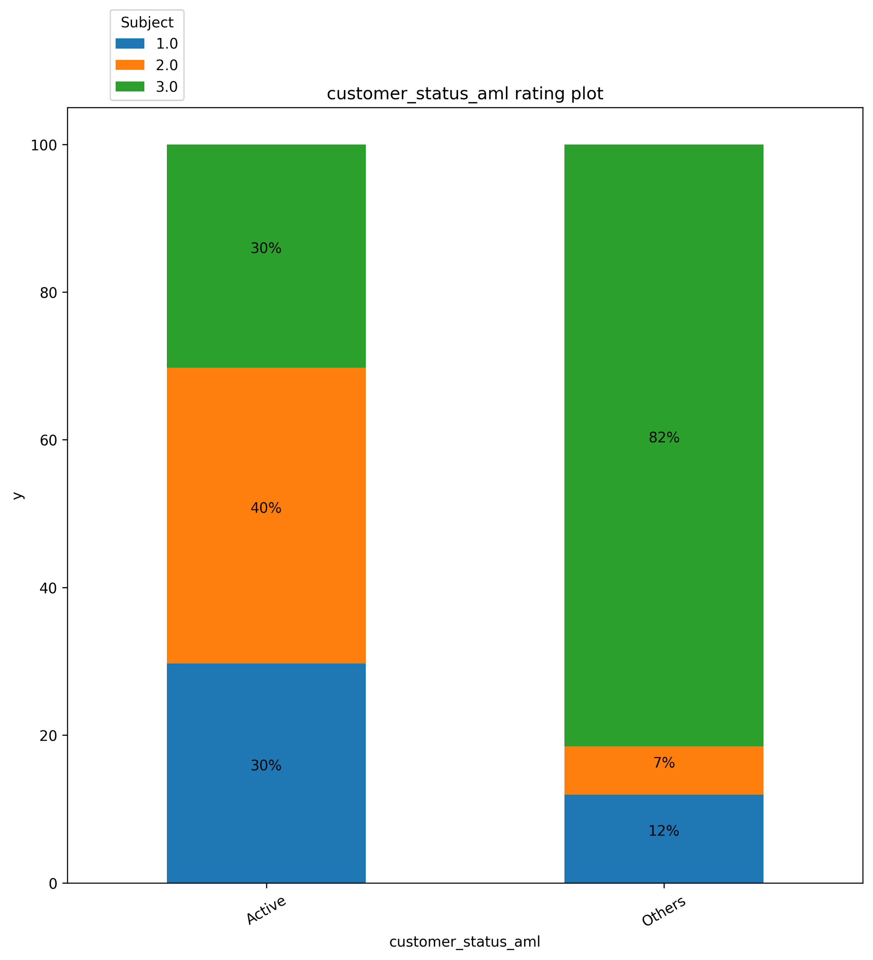
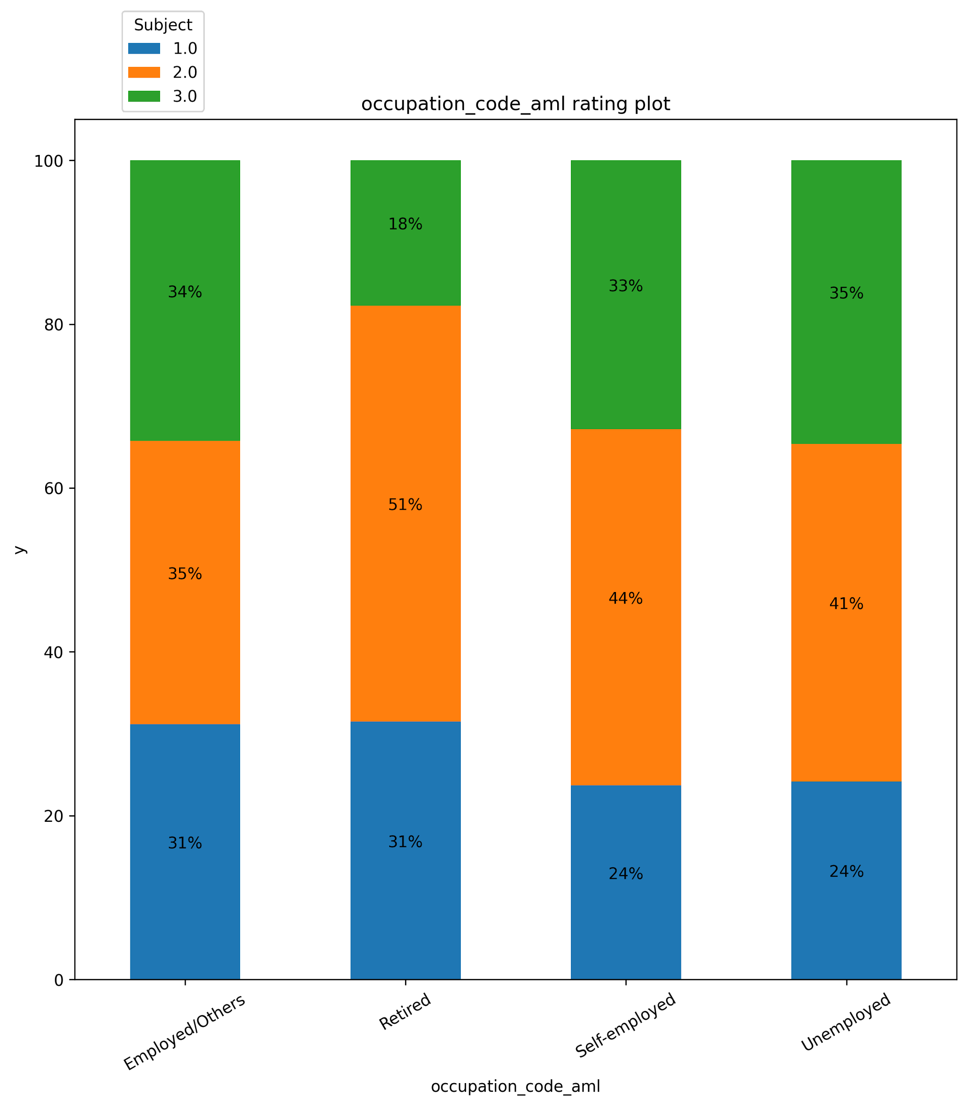
Exploratory Data Analysis
X
Key factors
Low Risk
Medium Risk
High Risk
Non Active User:
high risk of potential money laundry
Retired
less likely to have high risk, but have high medium risk
Customer Status:
Active vs Others(Pending, Not a customer & Inactive)
Occupation Code:
Employed, Retired, self-employed, unemployed
Notes:
After performing a crosstab analysis, we have identified a few interesting finding where Non-Active User tend to have high risk for money laundry which is shown on the left graph. In terms of occupation, the retired is less likely to have high risk.

Slide 9
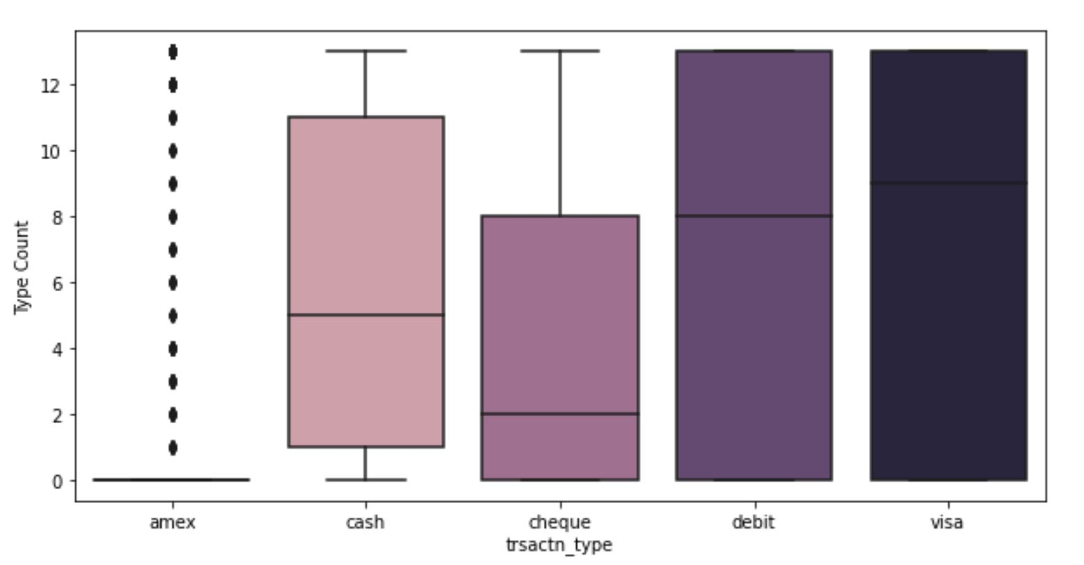
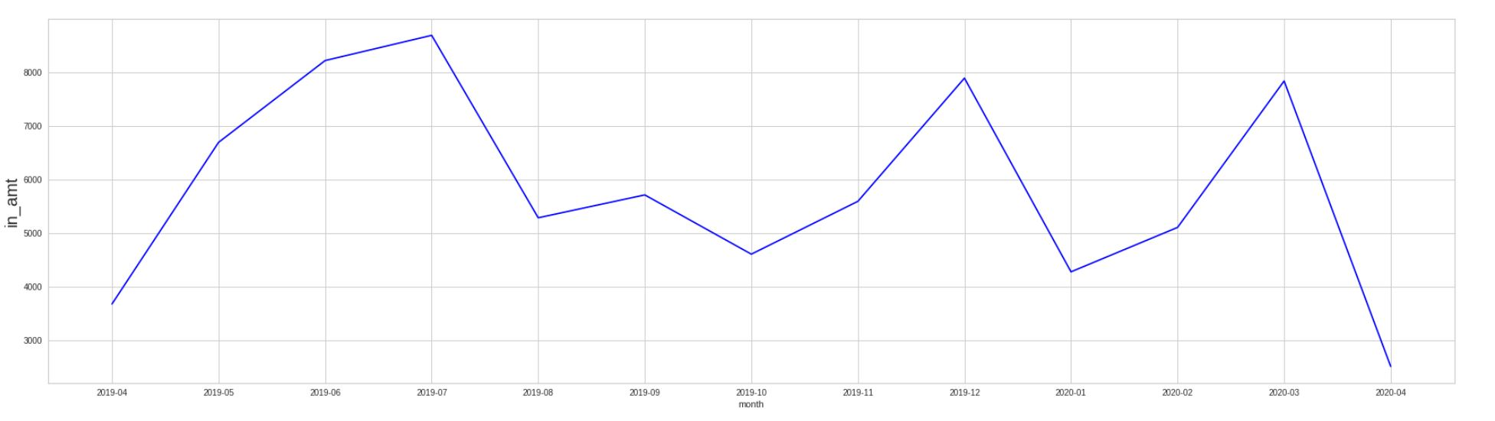
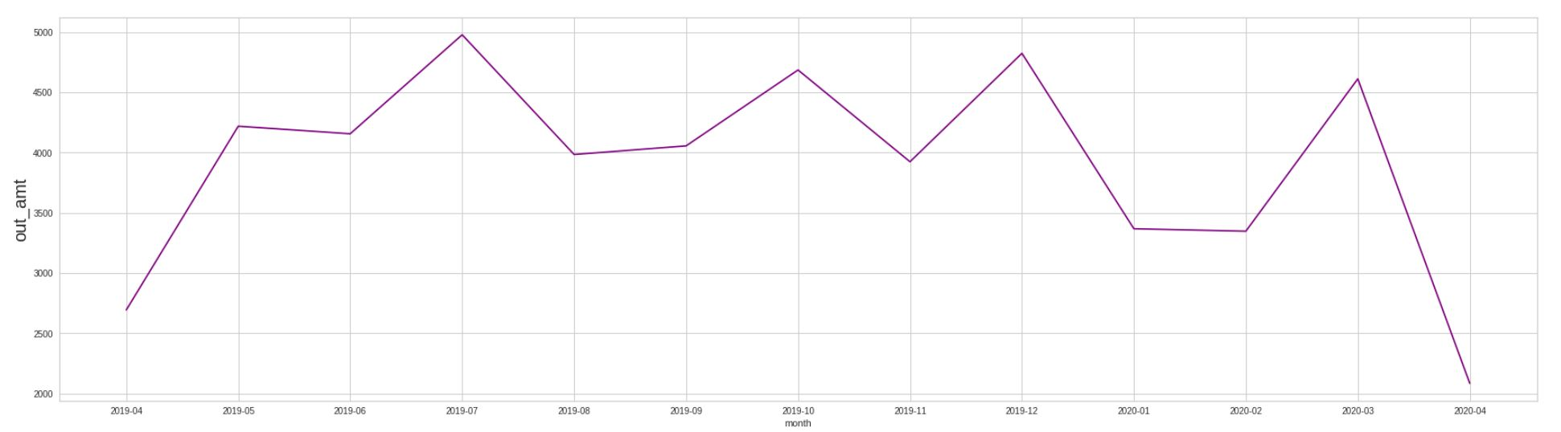
Exploratory Data Analysis
X
Data Overview
Indicates seasonality of transactions
High value and volume during December holiday seasons
Transaction Type At Customer Level:
Individual Canadian customers
Limited use of amex, as mostly
Similar statistics for debit and visa
Average Incoming/Outgoing amount :
Notes:
In terms of the transaction data, there is a strong seasonality observed where high value and volume during December holiday seasons and low during the April. It is also interesting to see that most of Candian do not use American Express, and have a similarly behavior with debit and visa.

Slide 10
3. Modeling Approach
Easy and Medium Model
Notes:
And now i will pass on to Devashree to talk about our modeling approach

Slide 11
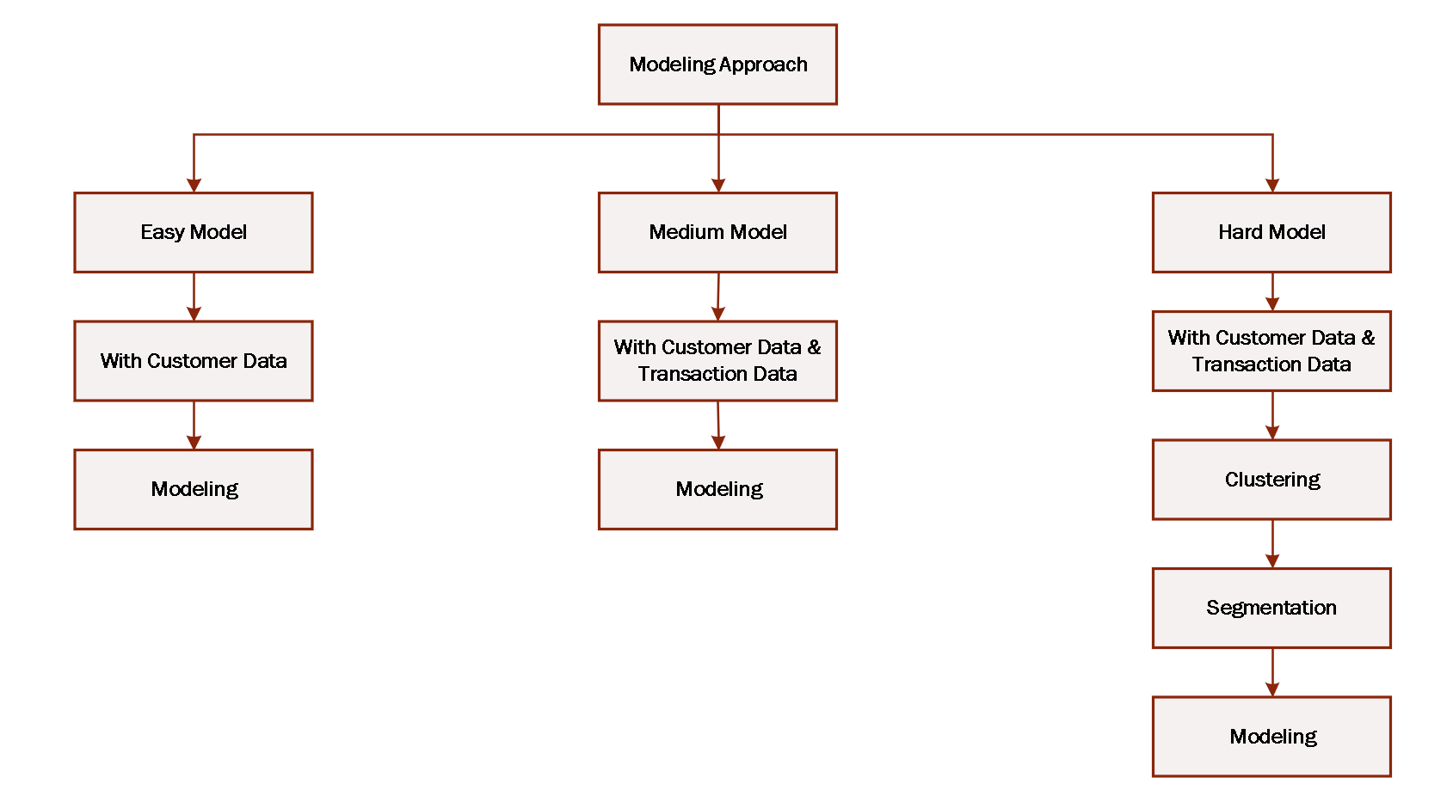
Modeling Approach
X
Approach
Notes:
And how hard model would work
Cluster the labeled dataset=> Find the cluster characteristics of labeled dataset=> Find optimal models for each cluster => cluster the big dataset using model fit on labeled dataset => validate the clusters with big dataset => track customers in high potential risk clusters => use optimal models to predict ratings for the big dataset
Assumptions:

Slide 12
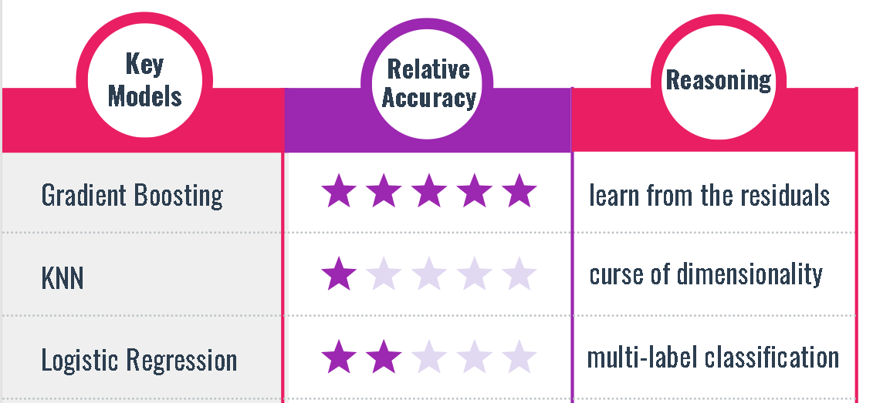
Modeling Approach
X
Supervised modeling with customer data only (Easy Model)
Model Output by Test Accuracy
Pipeline Approach
Pipeline Models | Training Accuracy | Test Accuracy | Precision | Recall | F-1 score
Logistic Regression | 0.429 | 0.451 | 0.450 | 0.450 | 0.430
Decision Tree | 0.431 | 0.444 | 0.320 | 0.440 | 0.370
KNN | 0.413 | 0.429 | 0.440 | 0.430 | 0.430
SVC | 0.434 | 0.450 | 0.440 | 0.450 | 0.440
Random Forest | 0.448 | 0.456 | 0.440 | 0.460 | 0.440
Gradient Boosting | 0.451 | 0.460 | 0.450 | 0.460 | 0.460
Pipeline consisted of 6 models for comparison
GridSearchCV was utilized to find the optimal parameters for each model.
Best model was determined in terms of test set accuracy
F1 score, Recall, Precision, and AUC metrics were utilized as well for comparison
Best Model Overview
Test Accuracy: 46% AUC: 65.20%
Comparison among models:
Gradient Boosting - Best (learn from the residuals of the last grown trees)
KNN - worst (curse of dimensionality)
Logistic Regression - Poor performance (due to multi-label classification problem)

Slide 13
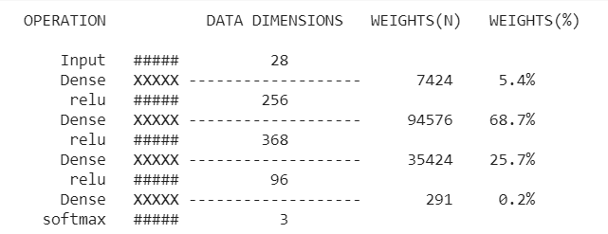
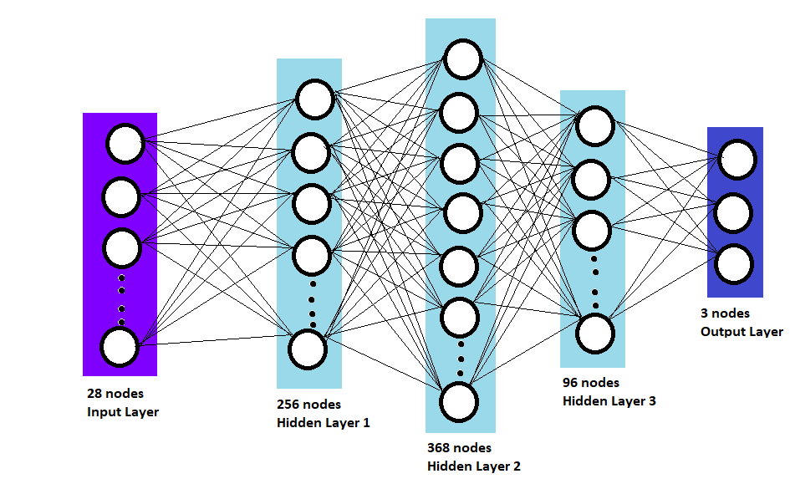
Modeling Approach
X
Supervised modeling with customer data only (Easy Model)
Model Overview: Neural Network Model
Model Output (Neural Network Model)
Neural network was performed with 1 input layer, 3 hidden layers and an output layer.
Keras Tuner was utilized to search and select the optimal number of neurons.
The 3 hidden layers has 256, 368 and 96 neurons.
The output layer has 3 target variables which is the rating separated into 3 response variables and the activation function used is ‘softmax’.
Test Accuracy : 47.58%
Hyperparameter Tuning:
The number of neurons that are used in the hidden layer was chosen between 16 to 512
Activation function types in the hidden layer were tested using relu and sigmoid
Model optimizers were tested using rmsprop

Slide 14
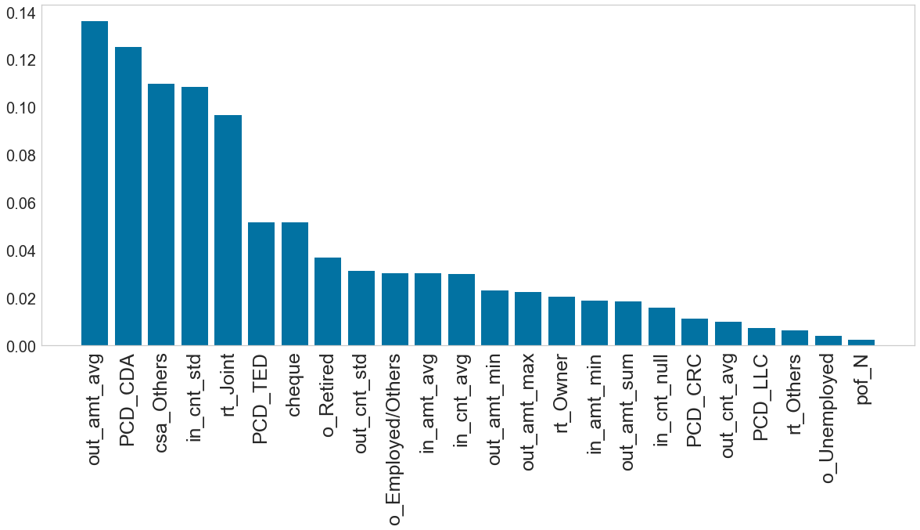
Modeling Approach
Feature Importance
*L1 Regularization to reduce predictors from 56 to 47
Important Predictors
Average Outgoing Amount
Count of Chequing Accounts
Customer Status: Others
Standard Deviation of Incoming Transaction Count
Joint Account Type

Slide 15
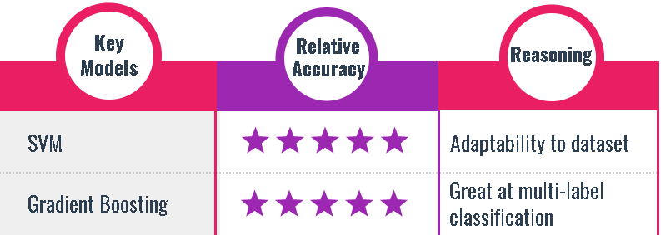
Modeling Approach
X
Supervised modeling with transaction data (Medium Model)
Model Output by Test Accuracy
Best Model Overview
Pipeline Models | Training Accuracy | Test Accuracy | Precision | Recall | F-1 score
Logistic Regression | 0.449 | 0.452 | 0.440 | 0.450 | 0.440
Decision Tree | 0.456 | 0.438 | 0.440 | 0.440 | 0.440
KNN | 0.431 | 0.434 | 0.430 | 0.430 | 0.420
SVM | 0.461 | 0.457 | 0.450 | 0.460 | 0.450
Random Forest | 0.480 | 0.444 | 0.430 | 0.440 | 0.420
Gradient Boosting | 0.456 | 0.456 | 0.450 | 0.460 | 0.450
70% of the dataset was used to train the model and 30% of the dataset for testing the model.
Test Accuracy: 46%
AUC: 64.60%
PARAMETERS
Learning Rate: 0.1
Loss function: deviance
Number of estimators: 100
Comparison among models:
Although SVM was shown to be the best model, Gradient Boosting Classifier performed similarly with 0.001 difference in test accuracy.
Gradient Boosting Classifier - better (due to multi-label classification problem)

Slide 16
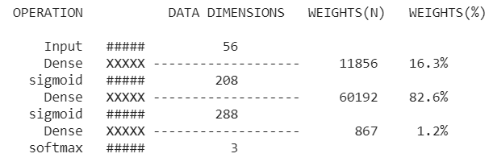
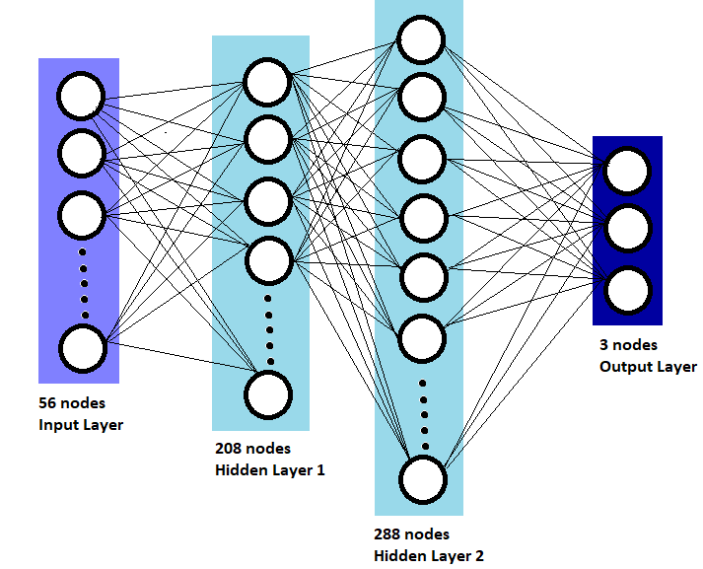
Modeling Approach
X
Supervised modeling with transaction data (Medium Model)
Model Overview: Neural Network Model
Model Output
Neural network was performed with 1 input layer, 2 hidden layer and an output layer.
Keras Tuner was utilized to search and select the optimal number of neurons.
The 2 hidden layer has 208 and 288 neurons.
The output layer has 3 neurons for each of the 3 ratings of 1,2 and 3.
Accuracy : 48.59%
Hyperparameter Tuning:
The number of neurons that are used in the hidden layer was chosen between 16 to 512
Activation function types in the hidden layer were tested using relu and sigmoid
Model optimizers were tested using rmsprop

Slide 17
4. Clustering & Segmentation
Hard Model
Notes:
And now i will pass on to Humza to talk about our clustering and segmentation

Slide 18
Clusterings for Segmentation
X
Approach
Hard Model
Cluster Labeled Dataset [K-Means]
Predict Cluster for Big Dataset Using Labeled Dataset Fit
Find Cluster Characteristics
Determine Optimal Model per Cluster
Validate Cluster Characteristics
Predict Ratings Using Cluster Optimal Models
*Ratings not used as variable for clustering algorithm
Notes:
And how hard model would work
Cluster the labeled dataset=> Find the cluster characteristics of labeled dataset=> Find optimal models for each cluster => cluster the big dataset using model fit on labeled dataset => validate the clusters with big dataset => track customers in high potential risk clusters => use optimal models to predict ratings for the big dataset
Assumptions:

Slide 19
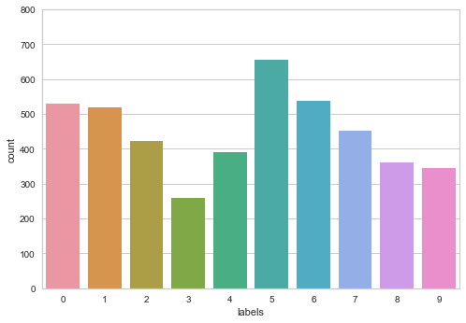
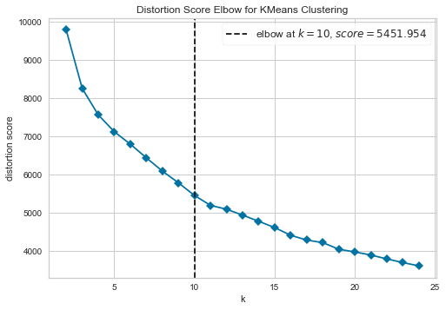
Clusterings for Segmentation
X
Hard Model
Model Overview: Clustering Model
Model Overview: Segmentation Model
Unsupervised learning algorithm where there is no target variable.
K=10 from elbow method criterion.
Both BIRCH and K-means were used to create labels and compared to determine which is the best clustering model.
K-means was also conducted without the ratings to compare future clusters.
The optimal model for each cluster is created from K-means.
Accuracy and Recall rate was utilized as the evaluation metric.
Models used include Logistic Regression, KNN, Decision Tree Classifier, Random Forest, SVC, and Gradient Boosting Classifier and neural networks
10-Fold Cross-Validation was utilized with 60/40 split
Cluster Label Distribution
Selecting Optimal K

Slide 20
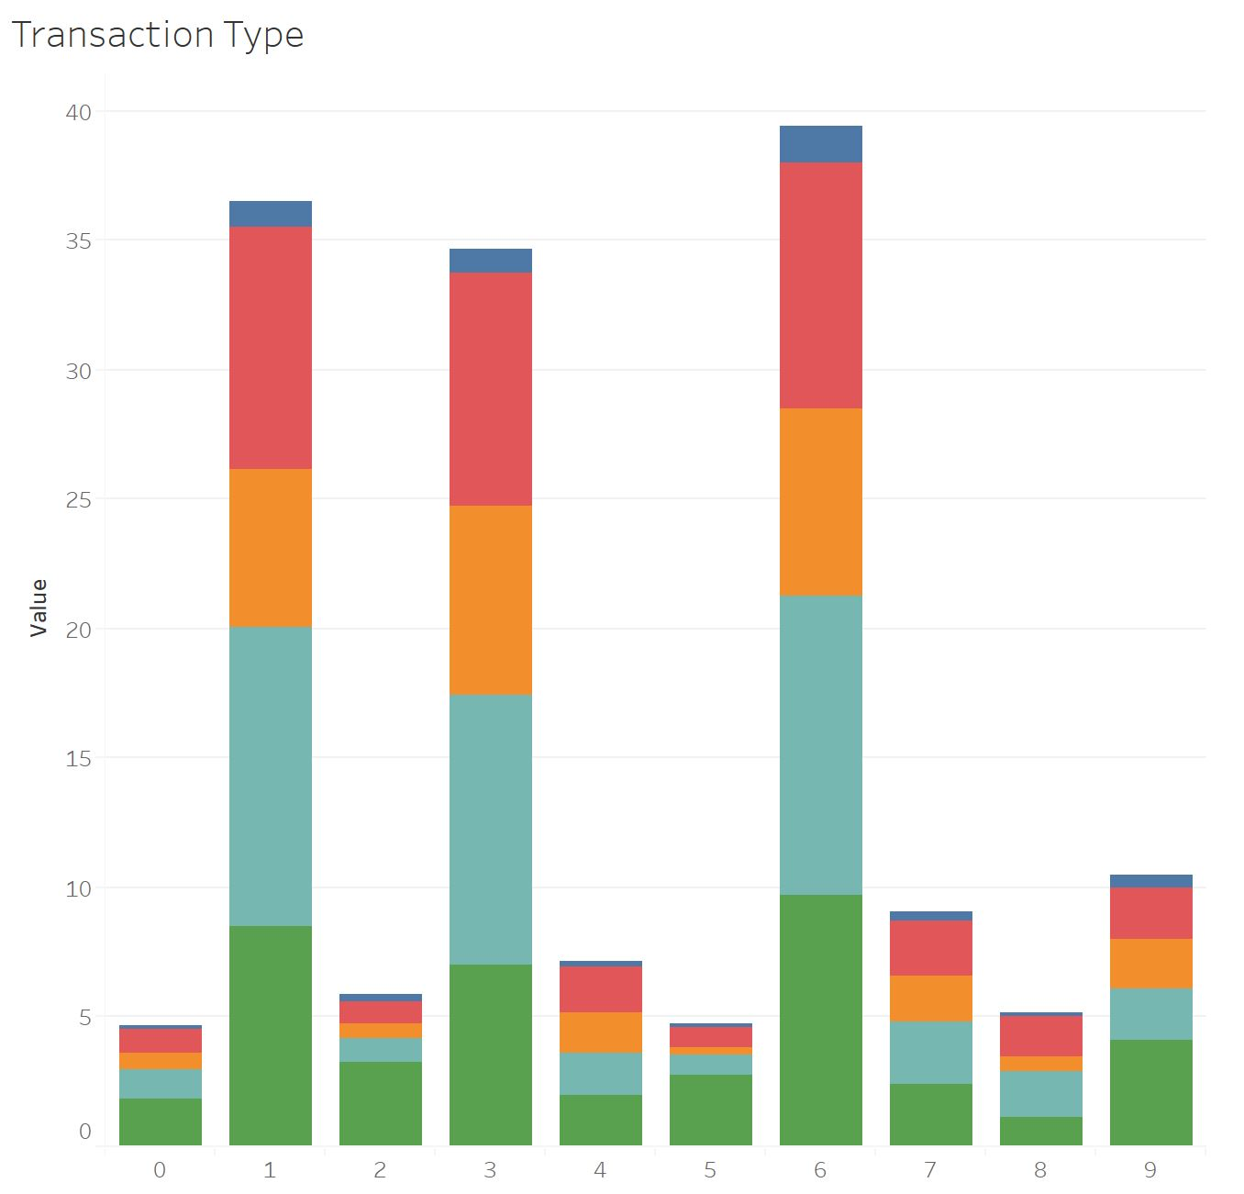
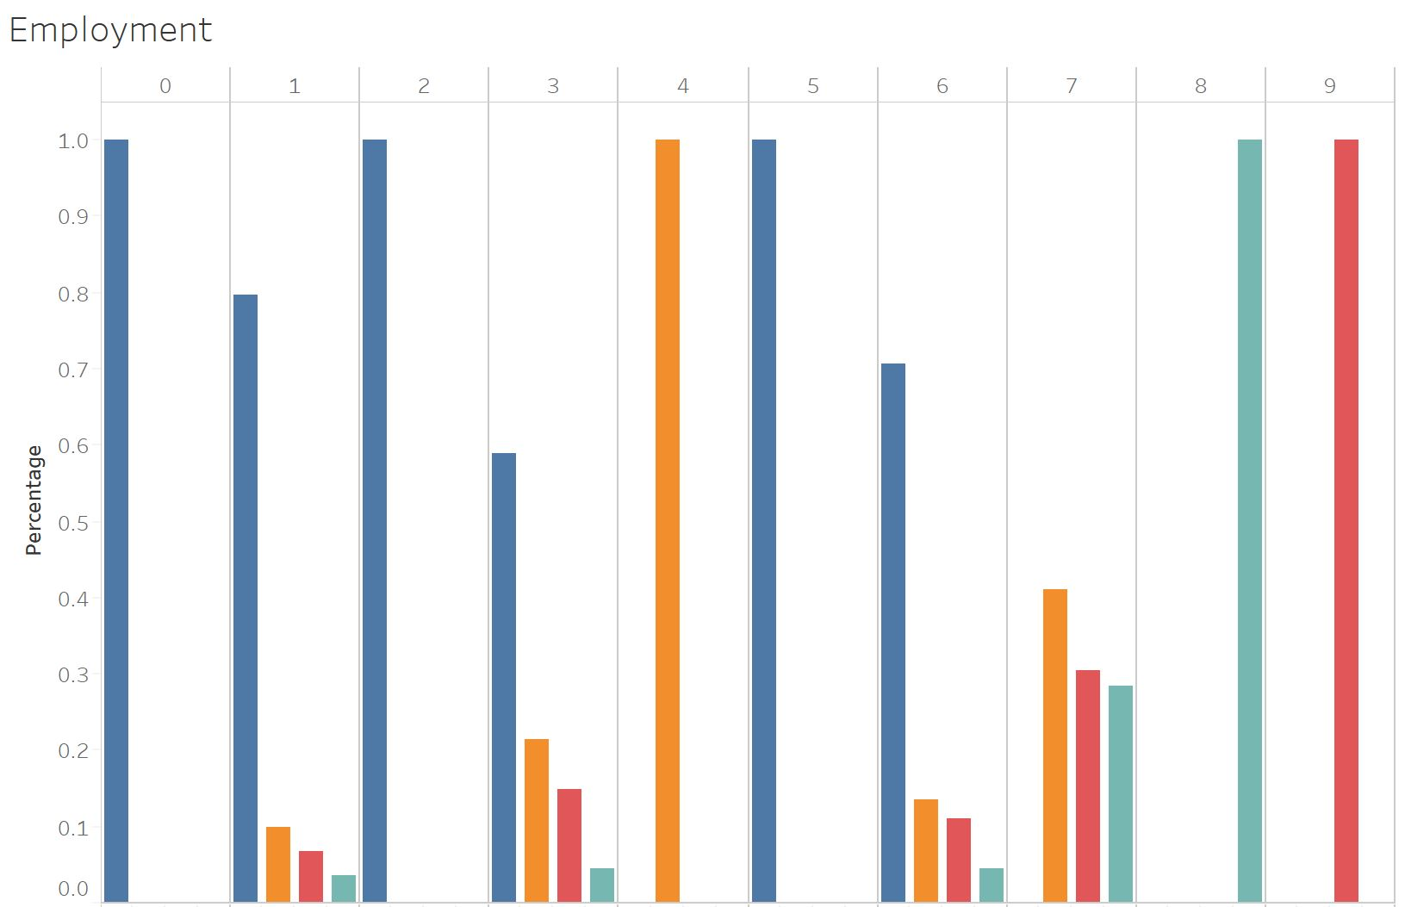
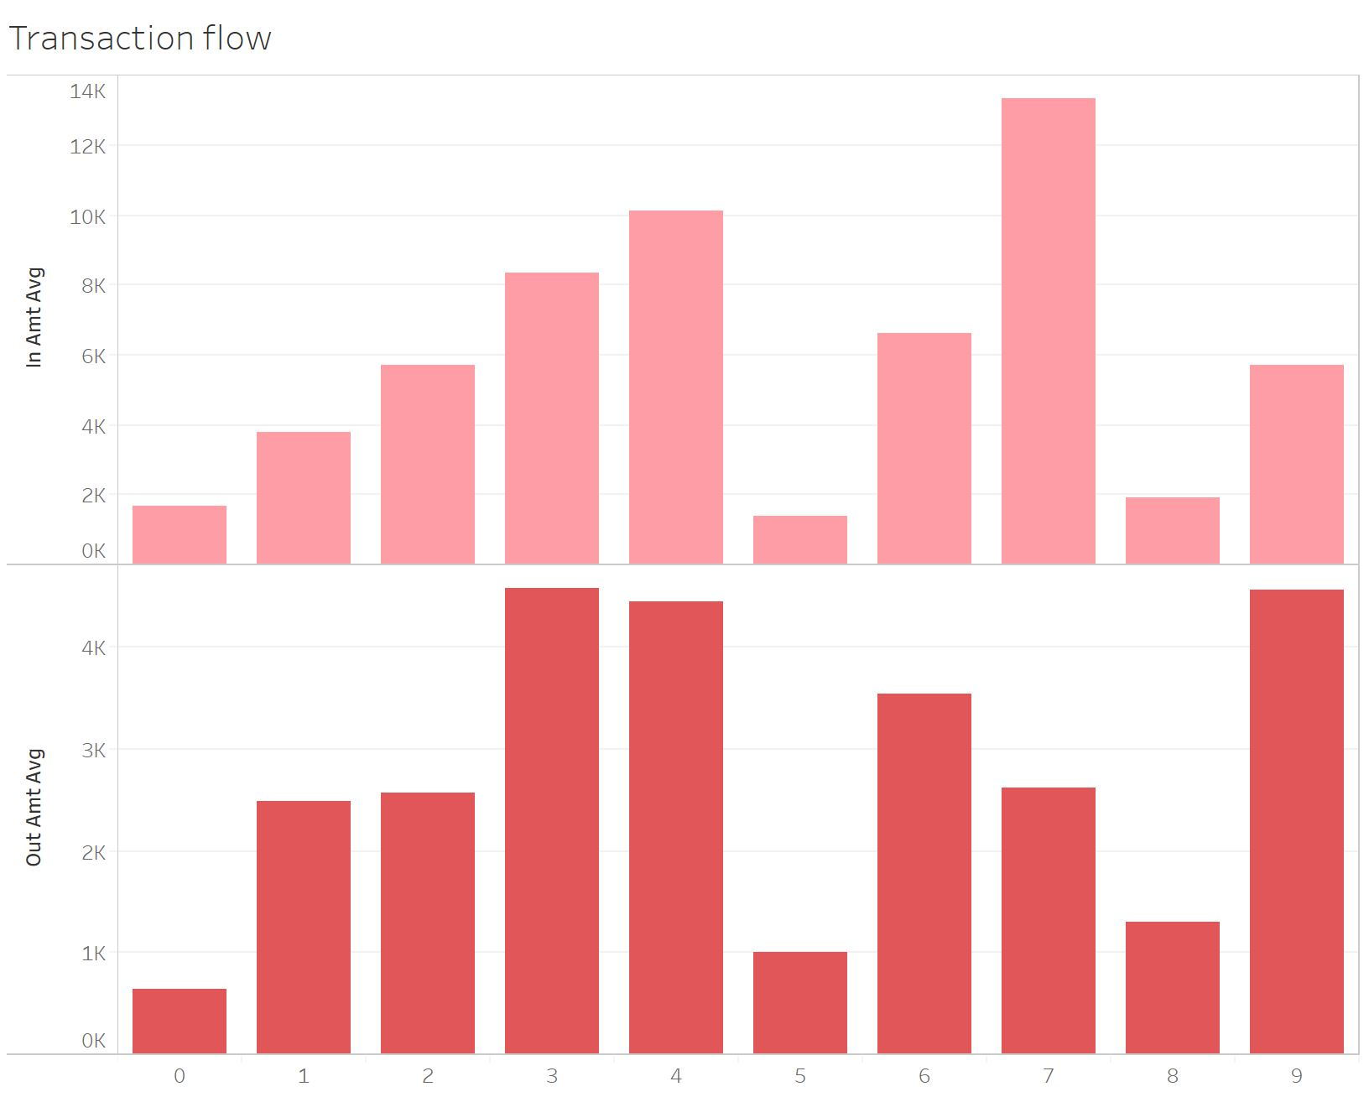
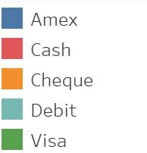
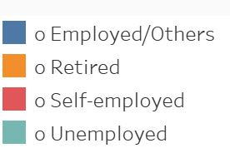
Clusterings for Segmentation
X
Cluster Characteristics
In and out imbalance shown in some clusters
Some clusters show consistent transaction behaviours while others have great volatility
Visa usage is particularly high in several clusters
Within most clusters, customers either have only one type of employment or a dominant type.
Notes:
After creating clusters, we look into cluster features. And we found different clusters have some obvious differences. A summary table of all of the different characteristics of the ten clusters is shown in the Appendix. And here we show some representative characteristics
The graph on the left is a simplified version of the transaction flow diagram we created.
We found Cluster 3 and 4 have both high incoming/outgoing amount, while cluster 7 show high incoming amount but cluster 9 only has a high outgoing amount. Also, cluster 0,5,8 have both low incoming and outgoing amount.
The graph in the middle shows the percentage of each type of transaction within each cluster, one obvious characteristic is cluster 1,2,5,7 have high visa usage which accounts for 35% to 55% of all their transactions.
The graph on the right shows the different types of employment that customers within each cluster have.
Cluster 0,2,5 only have employed customers. Cluster 4 only has retired customers, cluster 8 only has unemployed customer while cluster 9 only has self-employed customers.

Slide 21
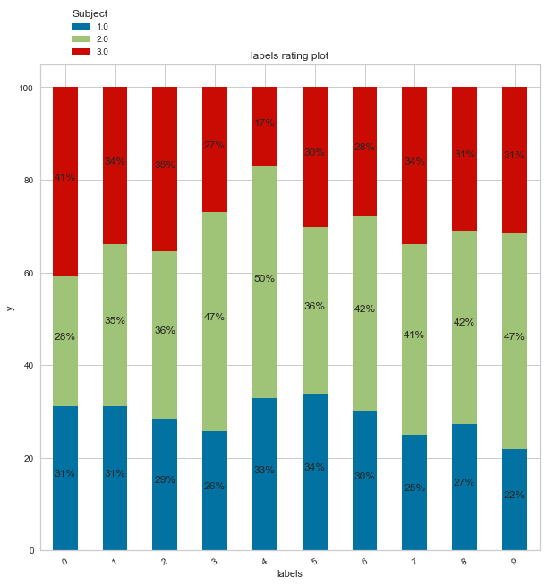
Clusterings for Segmentation
X
Characteristics Summary
Ratings
Potential high risk money laundering related characteristics:
High percentage usage of visa (cluster 0,9)
High percentage of credit cards (cluster 7,9)
Self-employed (cluster 9)
Joint accounts (cluster 7)
High positive average net incoming amount (incoming amount minus outgoing amount) (cluster 7)
High but inconsistent outcoming amount (cluster 9)
High but inconsistent incoming amount (cluster 7)
Potential low risk money laundering related characteristics:
Active accounts (cluster 4)
Retiree (cluster 4)
Owner relationship type (cluster 6)
High percentage of term deposits (cluster 6)
Notes:
After comparing clusters different characteristics and their different rating compositions. We are trying to answer the questions, what features are related to high risk of money laundering, and what features are not related to high risk of money laundering.
Here we list by rank some characteristics that are potential related to money laundering, (with representative clusters shown in the brackets).
The first one is high percentage usage of visa (shown in cluster 0 and 9).
The next is high percentage of credit cards (shown in cluster 7 and 9)
Followed by self-employed, joint accounts and so on.
We also summarize the features are not related to high risk of money laundering in other words more related to low risk of money laundering.
These are active accounts, retiree, owner relationship type and high percentage of term deposits.
For other characteristics that have no association with high risk or low risk, they fall into the middle category.
One thing to mention here is, this list is not absolutely conclusive, meaning that there are some violations such as some clusters show a high percentage of credit cards, but they do not have the highest percentage of high risk rating. Therefore, these features can only show some possible risk trends but do not determine the classification of the ratings.
But indeed these characteristics can help us with the cluster labelings, the validation on the big dataset.

Slide 22
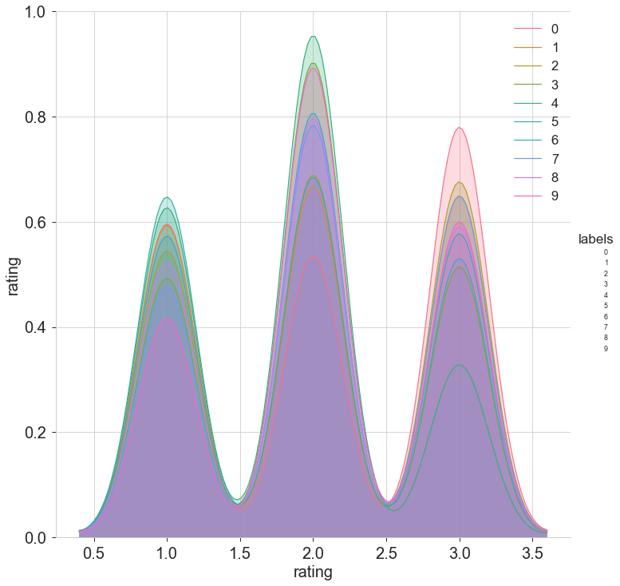
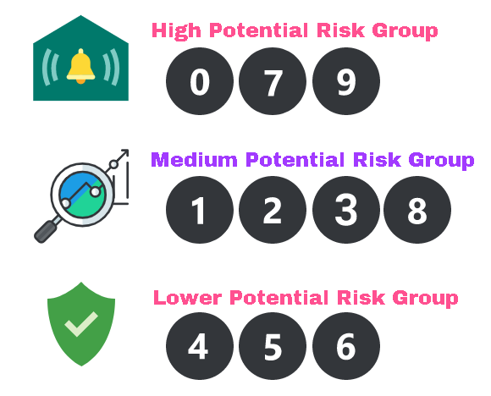
Clusterings for Segmentation
X
Cluster Profiles
Rating Distribution
Cluster Group Labels
Higher Potential Risk Group:
Cluster 0,7,9
Medium Potential Risk Group
Cluster 1,2,3,8
Lower Potential Risk Group:
Cluster 4,5,6
Notes:
Based on the cluster different characteristics, and the ratings compositions, we categorize cluster into 3 groups, the result is shown here. High potential risk group are cluster 0,7 and 9. Medium group is cluster 1,2,3, and 8. While low risk group is cluster 4,5,6. We suggest Scotiabank should focus on the higher potential risk group.

Slide 23
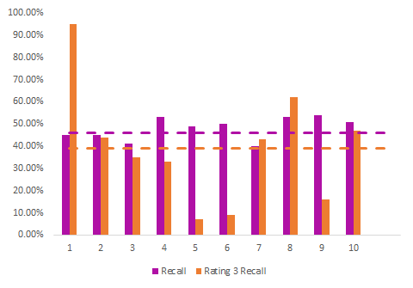
Clusterings for Segmentation
X
Optimal Models
Optimal Models Accuracy Rate Overview
Model Performance Metrics
Clusters | Logistic Regression | Decision Tree | KNN | SVC | Gradient Boosting Classifier | Random Forest | ANN | N
Cluster 0 | 0.373 | 0.396 | 0.354 | 0.377 | 0.420 | 0.448 | 0.260 | 212
Cluster 1 | 0.409 | 0.337 | 0.346 | 0.418 | 0.447 | 0.418 | 0.327 | 208
Cluster 2 | 0.385 | 0.385 | 0.367 | 0.402 | 0.385 | 0.408 | 0.367 | 169
Cluster 3 | 0.510 | 0.385 | 0.385 | 0.471 | 0.500 | 0.529 | 0.5 | 104
Cluster 4 | 0.494 | 0.481 | 0.449 | 0.442 | 0.455 | 0.481 | 0.461 | 156
Cluster 5 | 0.485 | 0.466 | 0.450 | 0.504 | 0.454 | 0.466 | 0.328 | 262
Cluster 6 | 0.386 | 0.400 | 0.386 | 0.386 | 0.377 | 0.400 | 0.386 | 215
Cluster 7 | 0.511 | 0.412 | 0.473 | 0.489 | 0.451 | 0.533 | 0.407 | 182
Cluster 8 | 0.510 | 0.524 | 0.538 | 0.531 | 0.531 | 0.545 | 0.4 | 145
Cluster 9 | 0.449 | 0.413 | 0.406 | 0.507 | 0.406 | 0.478 | 0.442 | 138
Test Accuracy and Recall on Rating Target Variable
Model Interpretation
Global model test accuracy was: 45.1% with the best model being Gradient Boosting Classifier.
The Weighted Test Set Accuracy was 47.77 %.
With cluster labels being validated we can assume similar performance with the giant dataset as we would with the smaller datasets.
*Dashed Line Global Model
Notes:
Neural Nets add it
0.25943396226415094
0.46153846153846156
0.3668639053254438
0.3269230769230769
CLuster 6 0.3282442748091603
Cluster 7:0.386046511627907
Cluster 8: 0.4065934065934066
Cluster 9: 0.4
Cluster 10: 0.4420289855072464

Slide 24
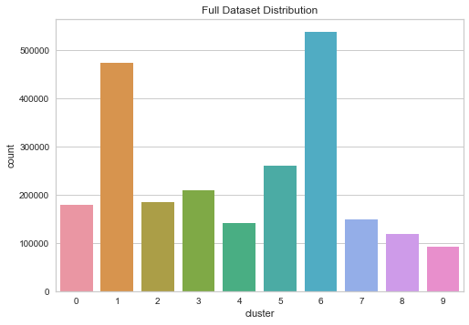
Clusterings for Segmentation
Predicting Labels on Big Dataset
Big Dataset Distribution
Big Dataset
Using K-Means algorithm fit on the labeled dataset, we predict the cluster labels for the big dataset.
Assumption: If the underlying characteristics of clusters between the two datasets are the same, then optimal models are valid to use.
Notes:
The training dataset is representative of the big dataset

Slide 25
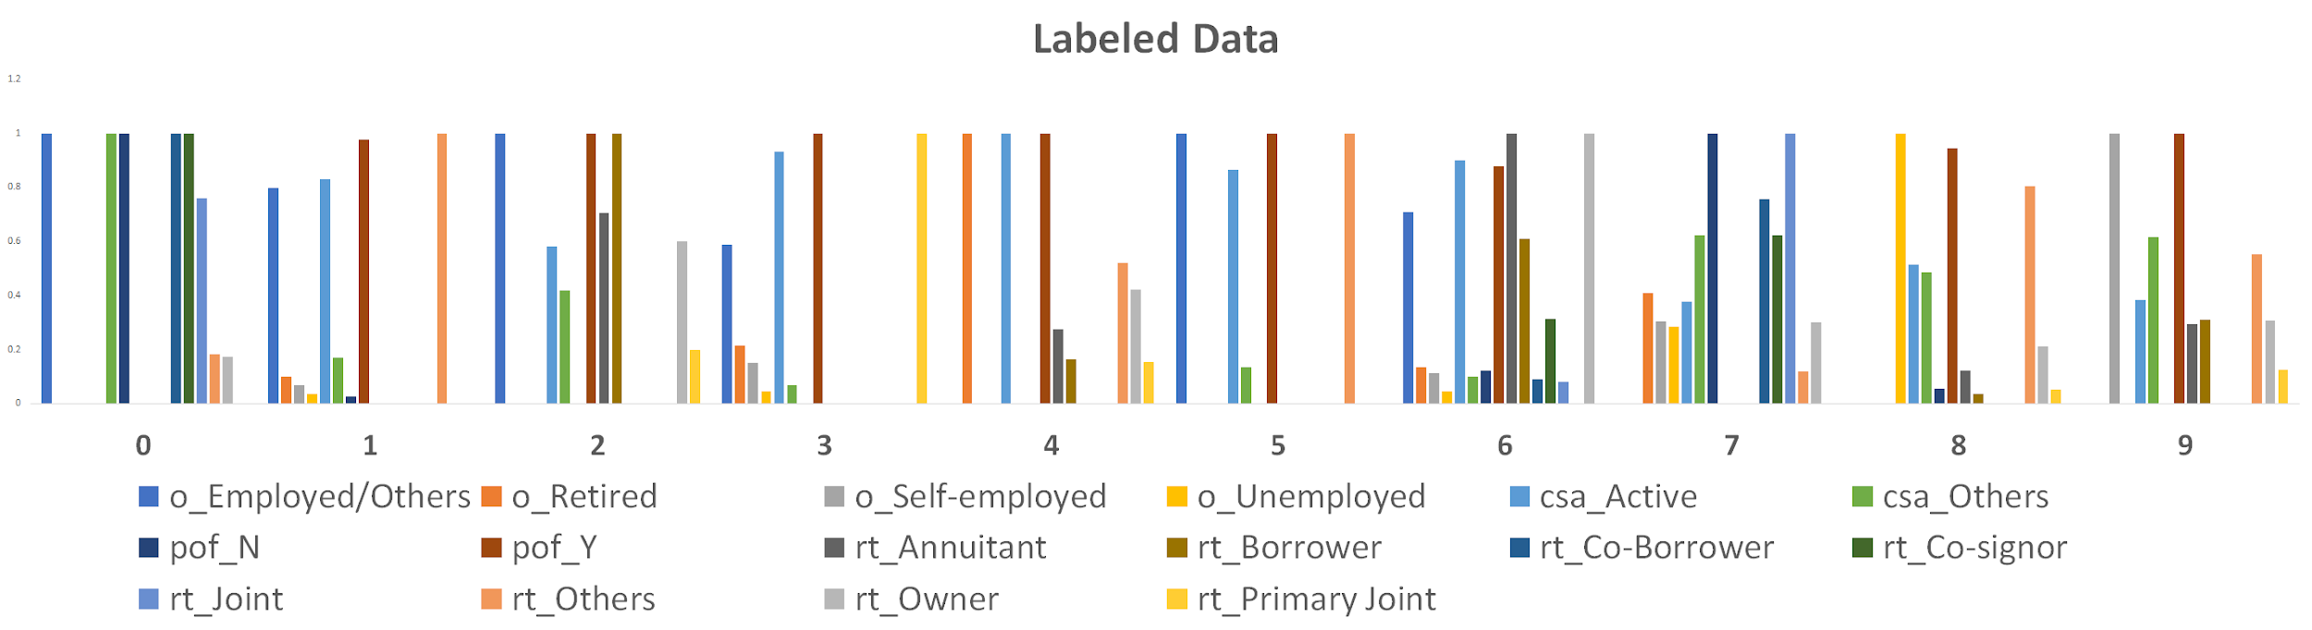
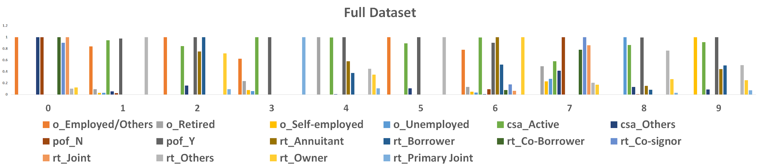
Clusterings for Segmentation
X
Validation between Labeled Dataset and Big Dataset
Labeled Dataset and Big Dataset Clusters demonstrate similar comparative patterns.
Labeled Dataset
Big Dataset
Notes:
Despite the results we cannot verify the accuracy of this training set, but we can validate the clusters.

Slide 26
6. Recommendation & Insights
Summary

Slide 27
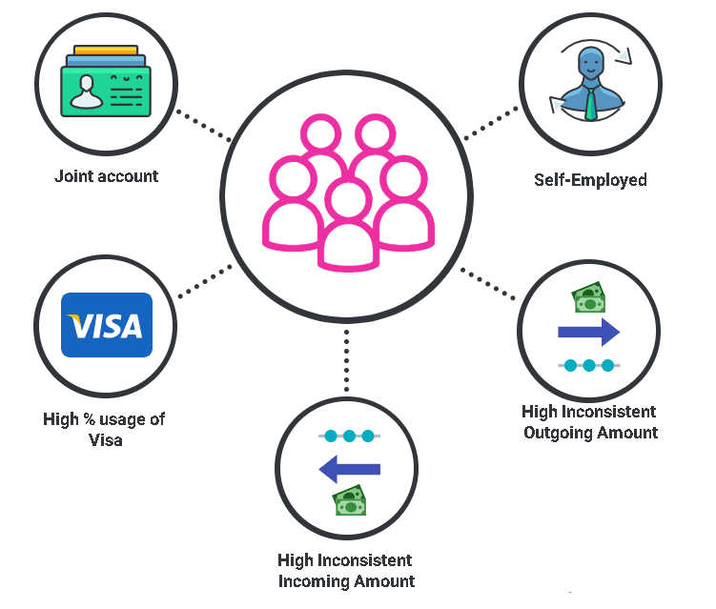
Recommendation & Insights
X
Overall Findings & Recommendation
Model Findings
Feature Findings
Easy and Medium Model provides…
High accuracy on prediction
But…
Unable to validate on big data
Low interpretability
Segmentation Model Improves…
Accuracy:
45.1%
47.8%
Interpretability for insights
Notes:
Thank you Humza. Through our analytics modeling, we have discovered that the easy and medium model is able to provide a high accuracy on th prediction, but unable to validate on the big dataset. The Segmentation improves the accuracy by clustering and is able to derive the insights for different features as shown. The customer with high % usage of visa, self-employed and inconsistent income amount is some obvious signs for money laundering risk.

Slide 28
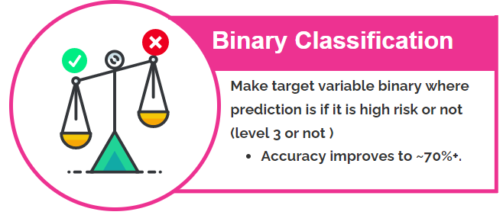
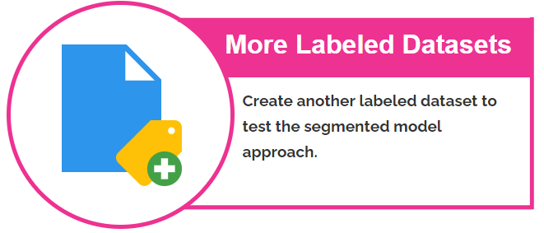
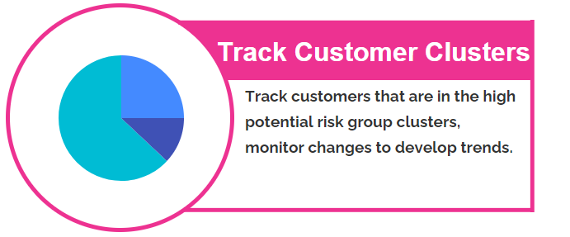
Recommendation & Insights
X
Next Steps
Notes:
Moving Forward, the team can increase the accuracy to predict binary target variable which can increase the accuracy for up to 70%. As the more labeled dataset available, the team is able to further improve the accuracy and develop new trends in support of the campaign.

Slide 29
Thank you
Questions?
Notes:
Thank you very much for listening. Now we are open to questions.

Slide 30
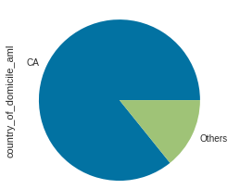
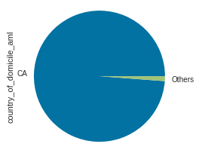
Country Code Distribution
Figure A1: (Left) Country Distribution for Training (Right) Country Distribution for Testing

Slide 31
Transaction Data
Table 1: Aggregate measures for transaction data
Original Columns | Incoming Amount Incoming Count | Outgoing Amount Outgoing Count | Others
Aggregated Columns | Count, Average, Max, Min, Standard Deviation | Count, Average, Max, Min, Standard Deviation | Number of Month without incoming or outgoing transaction, Number of transaction type used Usage Count for each type of transaction

Slide 32
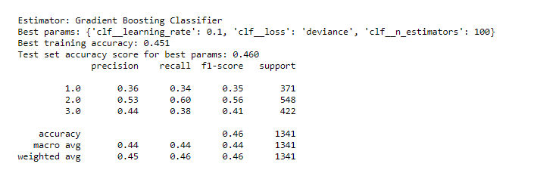
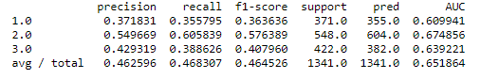
Easy Model
Pipeline - Results & Hyperparameters
Pipeline Models | Training Accuracy | Test Accuracy | Precision | Recall | F-1 score
Logistic Regression | 0.429 | 0.451 | 0.450 | 0.450 | 0.430
Decision Tree | 0.431 | 0.444 | 0.320 | 0.440 | 0.370
KNN | 0.413 | 0.429 | 0.440 | 0.430 | 0.430
SVC | 0.434 | 0.450 | 0.440 | 0.450 | 0.440
Random Forest | 0.448 | 0.456 | 0.440 | 0.460 | 0.440
Gradient Boosting | 0.451 | 0.460 | 0.450 | 0.460 | 0.460

Slide 33
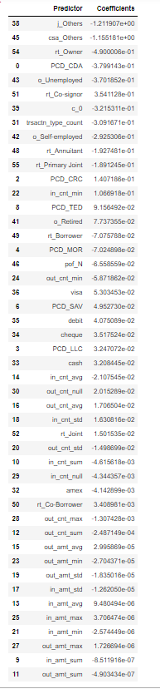
Lasso Regression
Medium Model Predictors
Figure D2: Feature Selection with Lasso Regression

Slide 34
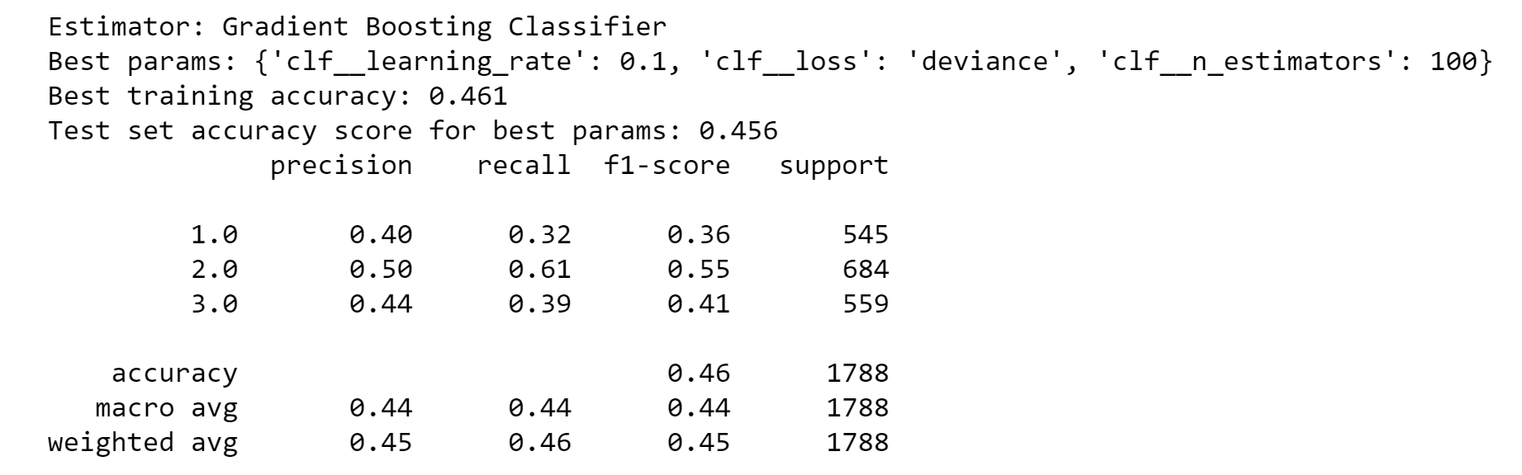
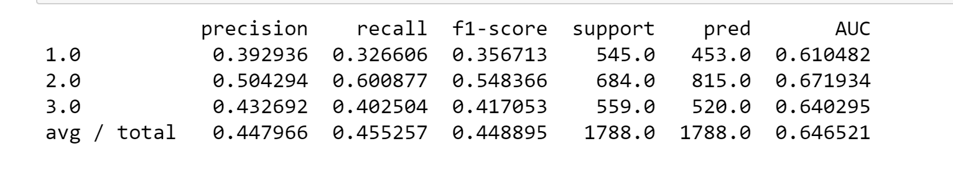
Medium Model
Pipeline - Results & Hyperparameters
Pipeline Models | Training Accuracy | Test Accuracy | Precision | Recall | F-1 score
Logistic Regression | 0.449 | 0.452 | 0.440 | 0.450 | 0.440
Decision Tree | 0.456 | 0.438 | 0.440 | 0.440 | 0.440
KNN | 0.431 | 0.434 | 0.430 | 0.430 | 0.420
SVM | 0.461 | 0.457 | 0.450 | 0.460 | 0.450
Random Forest | 0.480 | 0.444 | 0.430 | 0.440 | 0.420
Gradient Boosting | 0.456 | 0.456 | 0.450 | 0.460 | 0.450

Slide 35
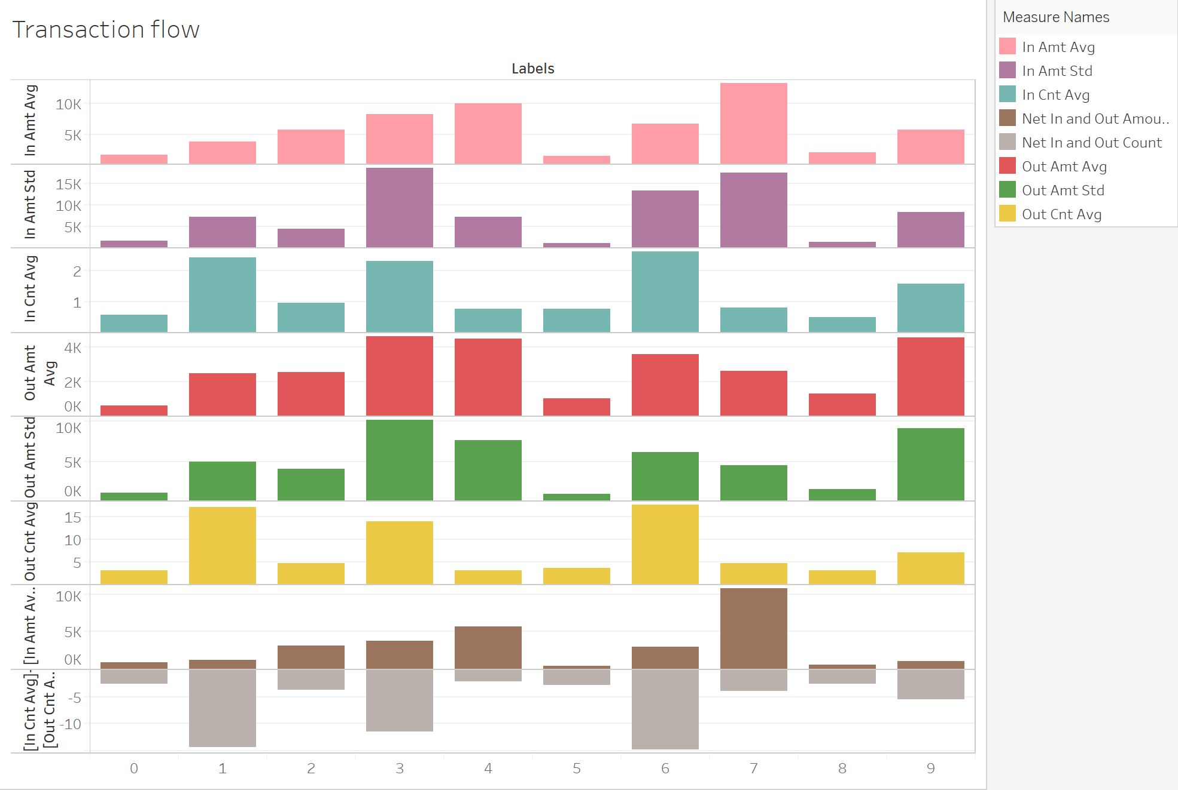
Cluster Characteristics
Figure F1: Transaction Flow Diagram

Slide 36
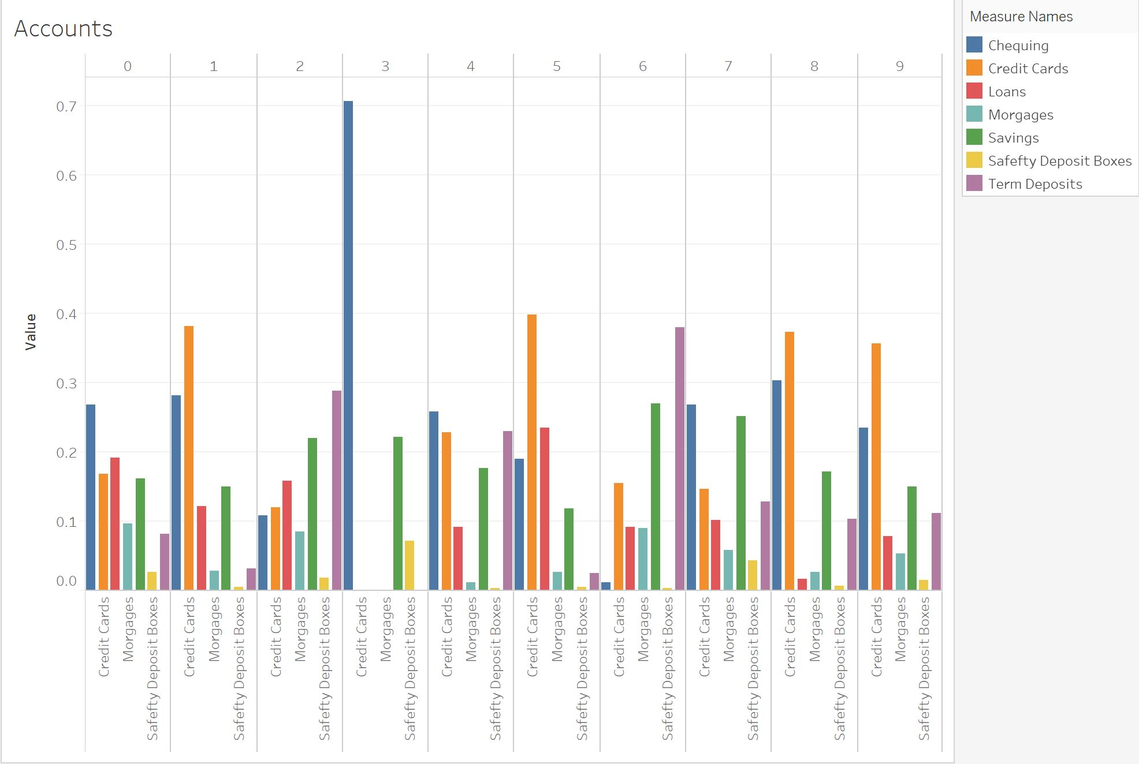
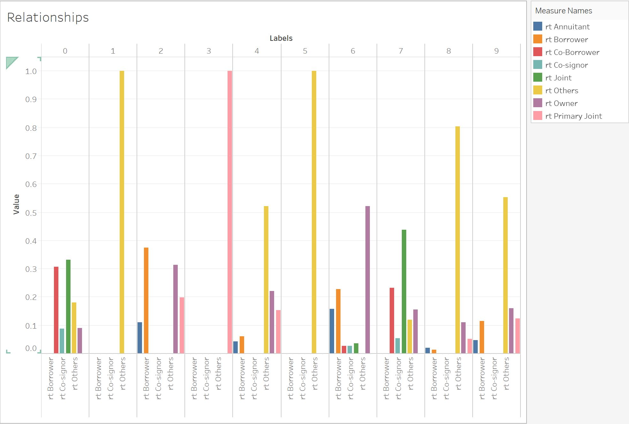
Clusterings for Segmentation
X
Cluster Characteristics
Different relationship types among clusters, dominant ones are obvious
Most accounts type is either chequing, credit card or term deposit.
Notes:
The graph on the left shows different types of account that customers within each cluster have.
For cluster 3 70% of accounts are chequing account. Cluster 1,5,8,9 have over 35% credit card account. While for cluster 2, 6 the most common accounts are term deposit.
The graph on the right shows the different relationship types within each cluster
Cluster 3 only has primary joint account while cluster 1,5 only have other types, which is also dominant type in cluster 4,8,9, while cluster 6 has over 50% percent of owner type.

Slide 37
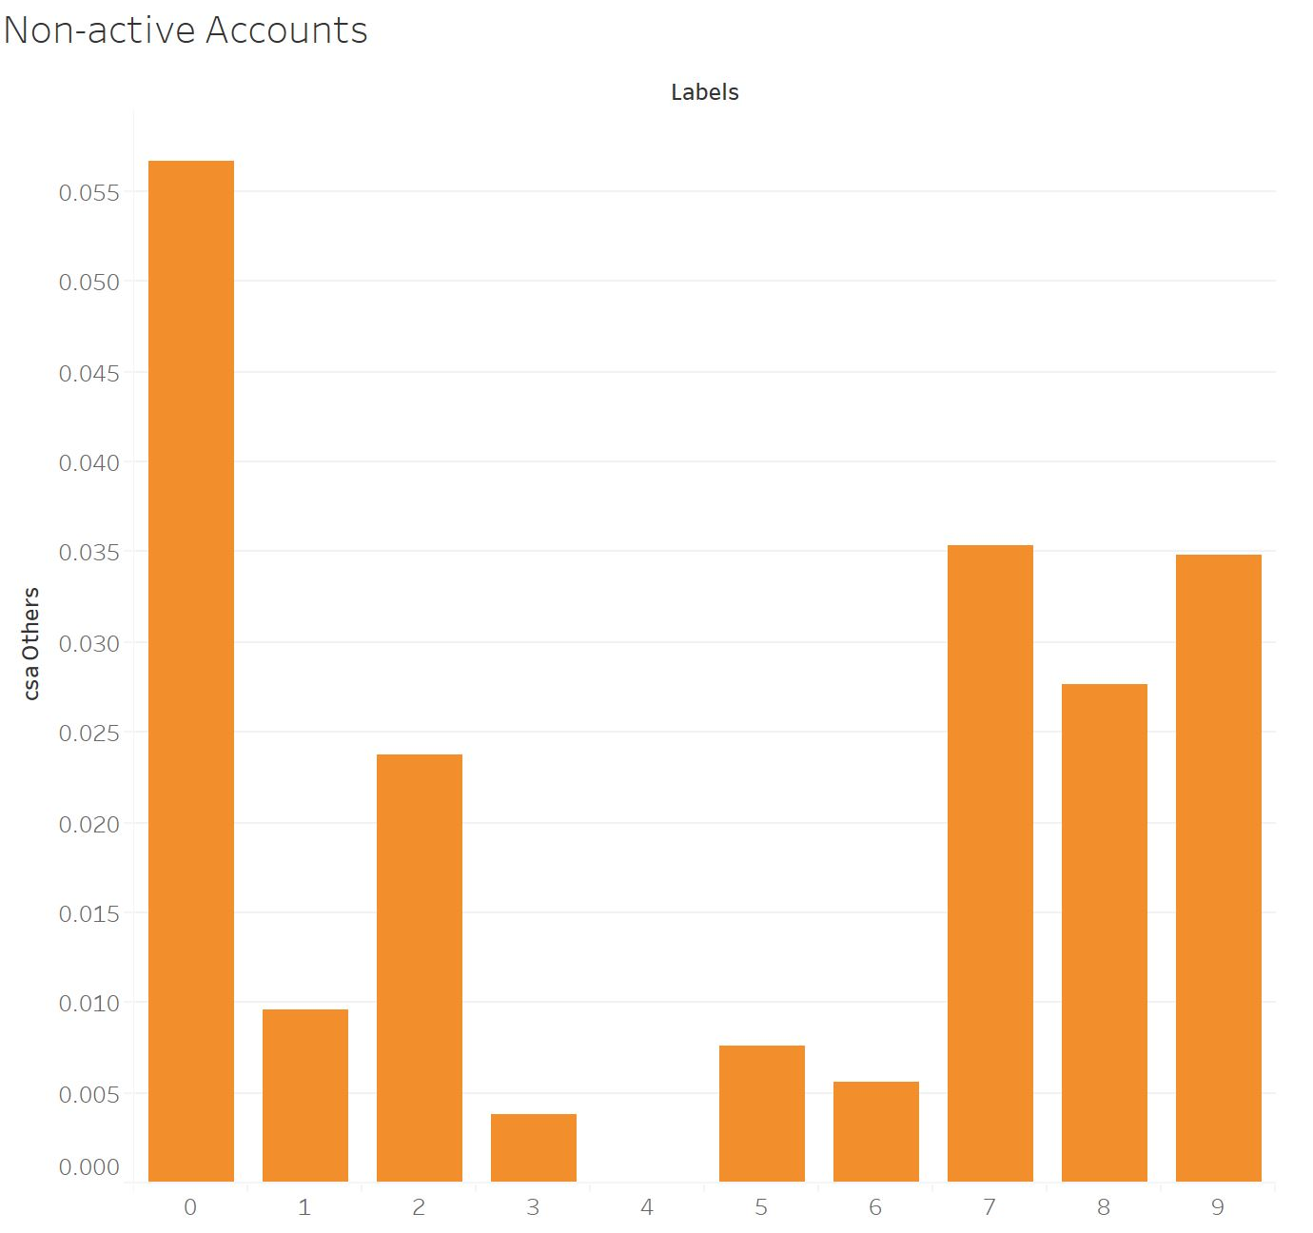
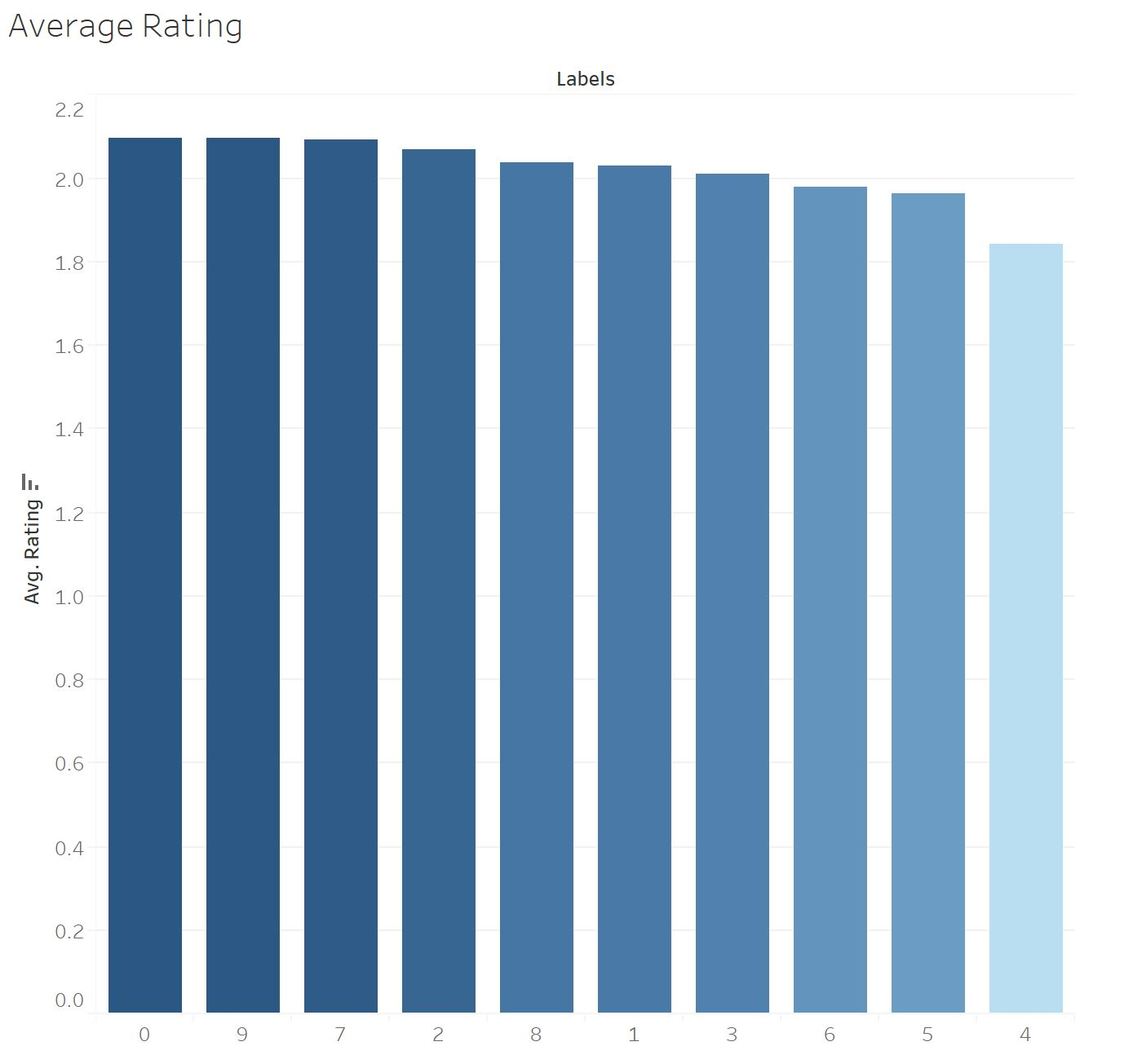
Clusterings for Segmentation
X
Summary
Notes:
Finding : What characteristic related to high risk of money laundering, what are not related to.
Representative clusters shown in the brackets
This is not inclusively, (some violations).
Start with strongest plausible connections

Slide 38
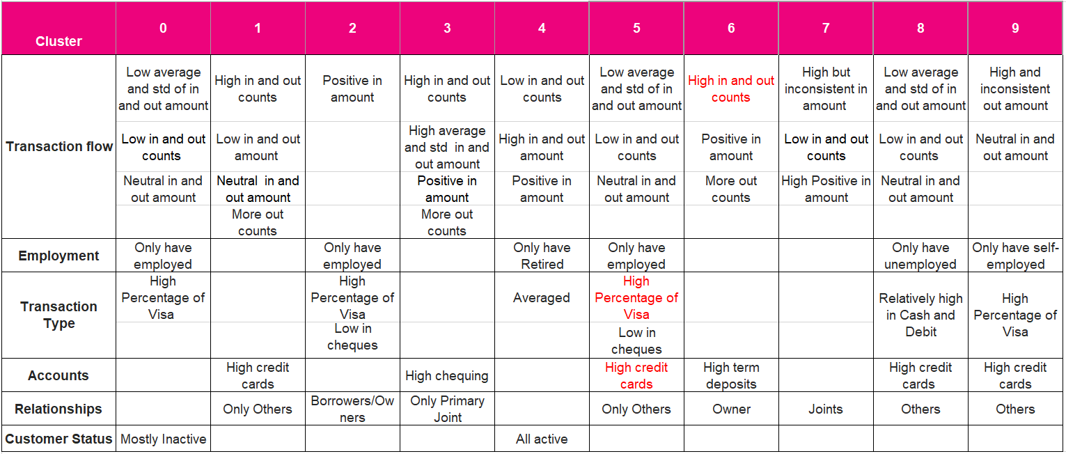
Cluster Characteristics Summary

Slide 39
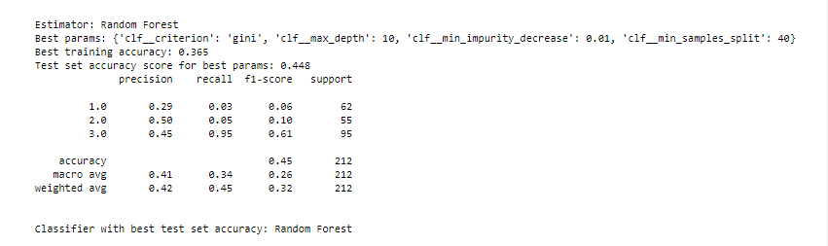
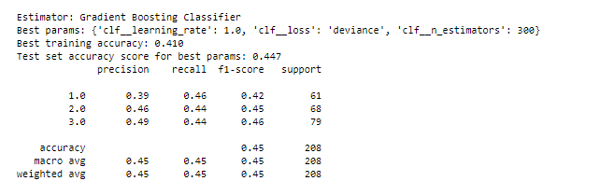
Hard Model Model Tuning
Cluster 1
Cluster 2

Slide 40
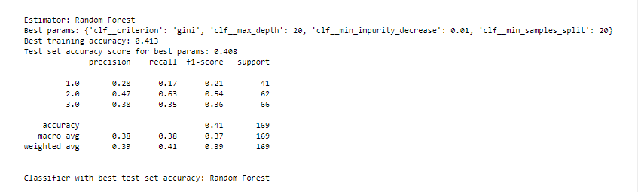

Hard Model Model Tuning
Cluster 3
Cluster 4

Slide 41


Hard Model Model Tuning
Cluster 5
Cluster 6

Slide 42


Hard Model Model Tuning
Cluster 7
Cluster 8

Slide 43


Hard Model Model Tuning
Cluster 9
Cluster 10

Slide 44

Rating Predictors Big Dataset

Slide 45


